Slide 1
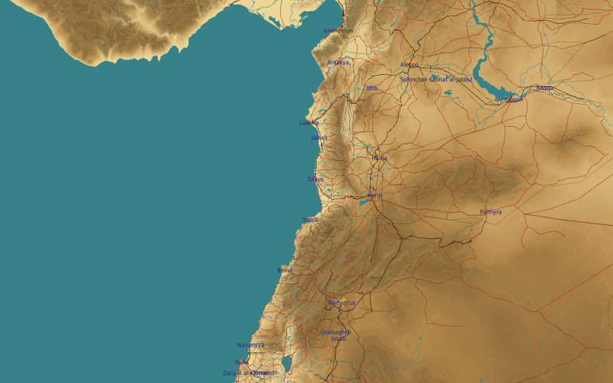
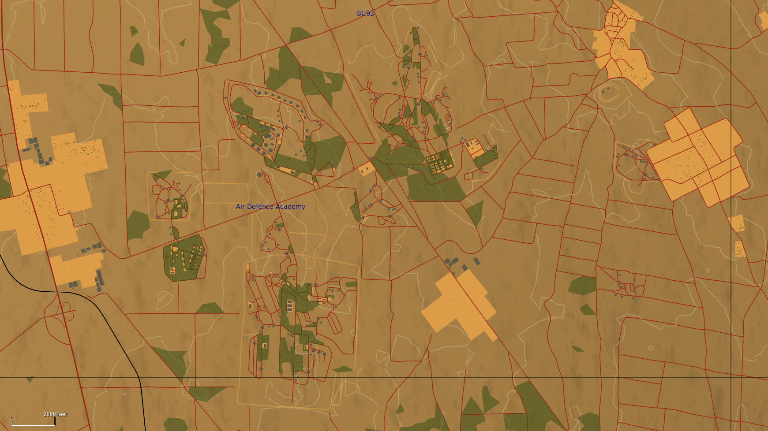
SYTGT062 SYR AIR DEFENSE ACADEMY
Storage area
Advanced training area
N
Training area
062
Training area
The Syrian Air Defense academy consist of five different training areas, one storage area and a administration area.
Administration:
Leadership and instructors are have their offices in this part of the academy.
Storage area:
Ammunition for live fire exercises are stored here when not deployed to the training areas.
Basic training and education:
When new SAM units are created, they are conducting their initial training in this part of the academy.
Advanced training area:
This is an area is the last stop befor beeing deployed as a operational combat ready unit.
Training:
This is an area used for various training.
Administration
Training area
Basic training and education
CENTREGRID: N34 36.800 E036 45.900, Elevation: 2128ft

